Slide 1
Digital Electronics III Semester B. Tech. ( CSE) Amrita School of Engineering, Bengaluru FF conversion and Registers

Slide 2
Flip-Flop Conversion
Steps for Flip-Flop Conversions:
Identify available and required flip flop.
Write characteristic table for required flip flop.
Write excitation table for available flip flop.
Make conversion table and using K-map write Boolean expression for available flip flop.
Draw the circuit.

Slide 3
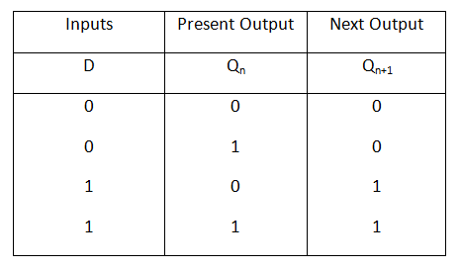
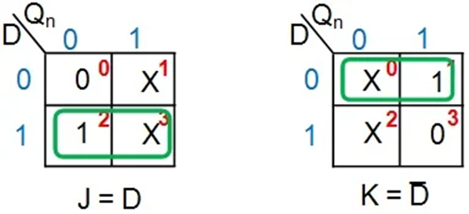
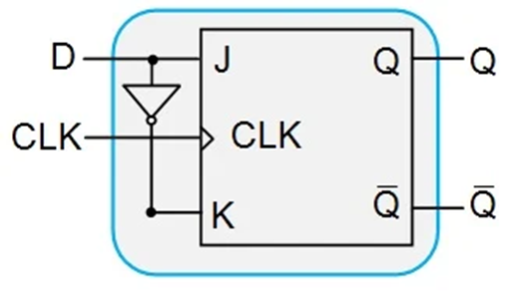
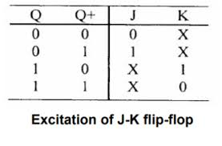
Conversion of a JK-to-D Flip-Flop
4. Conversion Table and Boolean Expression
Qn D | Qn+1 | J K
0 0 | 0 | 0 X
0 1 | 1 | 1 X
1 0 | 0 | X 1
1 1 | 1 | X 0
Available Flip Flop : JK Flip Flop
Required Flip Flop : D Flip Flop
2. Characteristic Table of Required FF: D Flip Flop
5. Circuit Diagram
3. Excitation Table of Available FF: JK FF

Slide 4
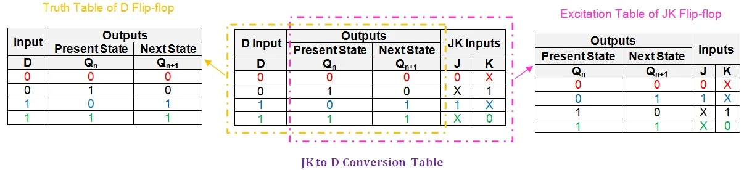

Slide 5
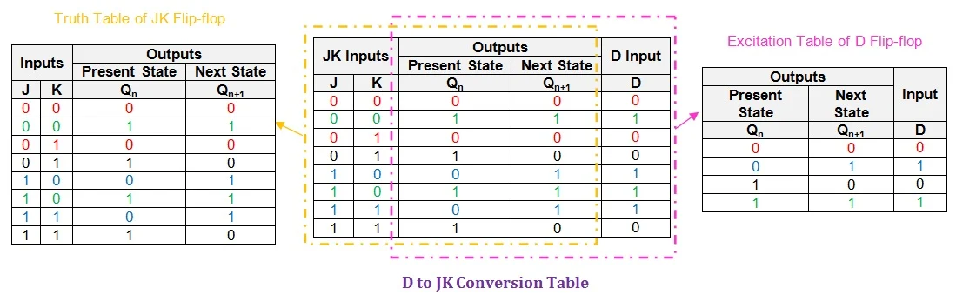
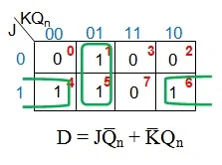
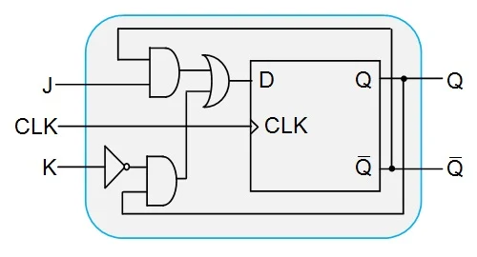
Conversion of D to JK Flip-Flop

Slide 6
Try Yourself:
SR FF to JK FF
D FF to T FF
T FF to D FF
JK FF to T FF

Slide 7
Convert a positive edge triggered JK flip-flop to a positive edge triggered XY flip-flop as defined by function table:
X Y | Qn+1
0 0 0 1 1 0 1 1 | 0 Q’ Q 1
The application table for the JK flip-flop and function table for the XY f1ip-flop are:
Q → Qn+1 | J K
0 0 0 1 1 0 1 1 | 0 X 1 X X 1 X 0
X Y | Qn+1
0 0 0 1 1 0 1 1 | 0 Q’ Q 1

Slide 8
Excitation Table:
Karnaugh Map for the J and K inputs
Cell No. | X Y Q | Qn+1 | J K
0 | 0 0 0 | 0 | 0 X
1 | 0 0 1 | 0 | X 1
2 | 0 1 0 | 1 | 1 X
3 | 0 1 1 | 0 | X 1
4 | 1 0 0 | 0 | 0 X
5 | 1 0 1 | 1 | X 0
6 | 1 1 0 | 1 | 1 X
7 | 1 1 1 | 1 | X 0
Converted Circuit:

Slide 9
Convert a positive edge triggered D flip-flop into the positive edge triggered XY flip-flop defined by below function table:
X Y | Qn+1
0 0 0 1 1 0 1 1 | 0 Q’ Q 1
Solution: The application table for the D flip-flop and the function table for the XY flip-flop are:
Q → Qn+1 | D
0 0 0 1 1 0 1 1 | 0 1 0 1
X Y | Qn+1
0 0 0 1 1 0 1 1 | 0 Q’ Q 1

Slide 10
Excitation Table:
Karnaugh Map for D input:
Converted Circuit:

Slide 11
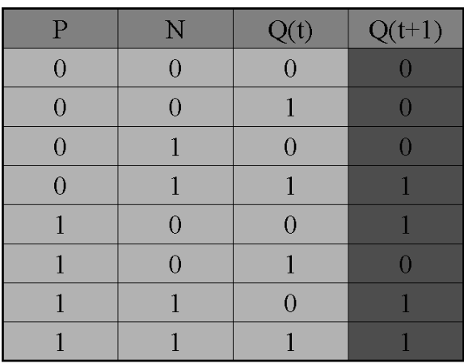
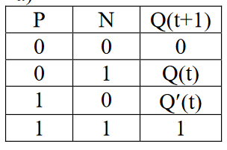
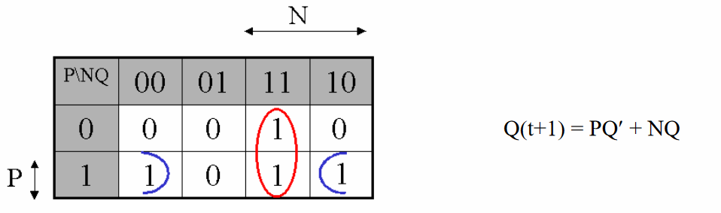
A PN flip-flop has four operations: clear to 0, no change, complement, and set to 1, when inputs P and N are 00, 01, 10, and 11, respectively.
a)Tabulate the characteristic table.
b)Derive the characteristic equation.
c)Tabulate the excitation table.
d)Show how the PN flip-flop can be converted to a D flip-flop.

Slide 12
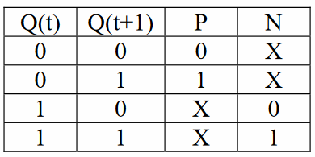

Excitation Table:
PN flip-flop can be converted to a D flip-flop,

Slide 13
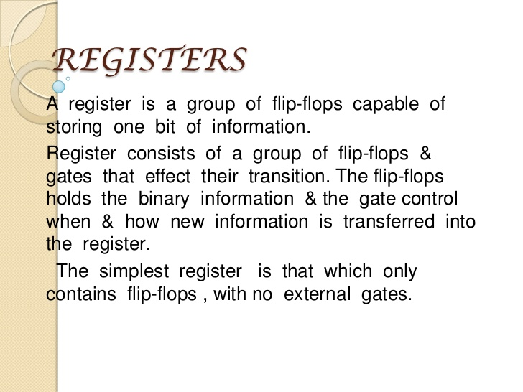

Slide 14
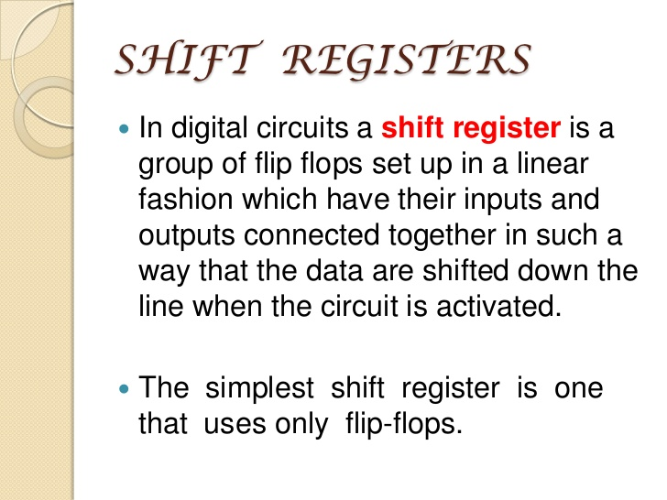

Slide 15
A Simple Shift Register
Figure shows a four-bit shift register that is used to shift its contents one bit-position to the right.
The data bits are loaded into the shift register in a serial fashion using the In input.
The contents of each flip-flop are transferred to the next flip-flop at each positive edge of the clock.

Slide 16
An illustration of the transfer is shown below, which shows what happens when the signal values at In during eight consecutive clock cycles are 1,0,1,1,1,0,0,and 0, assuming that the initial state of all flip-flops is 0.
To implement a shift register, it is necessary to use either edge-triggered or master-slave flip-flops. The level-sensitive gated latches are not suitable, because a change in the value of In would propagate through more than one latch during the time when the clock is equal to 1.

Slide 17
PARALLEL-ACCESS SHIFT REGISTER

Slide 19
Figure shows a four-bit shift register that allows the parallel access.
The control signal is used to select the mode of operation. If = 0, then the circuit operates as a shift register. If = 1, then the parallel input data are loaded into the register.
In both cases the action takes place on the positive edge of the clock.
A circuit in which data can be loaded in series and then accessed in parallel is called a series-to-parallel converter. Similarly, the opposite type of circuit is a parallel-to-series converter. The circuit shown can perform both of these functions.

